Slide 1
HAND SIGNALS WITH VISUAL DATA
BY
AYUSHYA AMITABH
CHRIS PANICAN
GERRY XU
OMAR ELNAGDY
Notes:
HELLO! OUR PROJECT IS HAND SIGNALS WITH VISUAL DATA

Slide 2
HAND SIGNALS WITH VISUAL DATA
ABSTRACT
Our project was to create a software to allow for gesture-based controls on the end user’s computer with the aid of deep learning to help recognize the user’s hand as well as the number of fingers being held up by the user.
BY
AYUSHYA AMITABH
CHRIS PANICAN
GERRY XU
OMAR ELNAGDY
Notes:
TO QUICKLY INTRODUCE OUR SELVES,
I'M AYUSHYA
...

Slide 3
HAND SIGNALS WITH VISUAL DATA
ABSTRACT
THE NEED FOR
HAND GESTURES
Our project was to create a software to allow for gesture-based controls on the end user’s computer with the aid of deep learning to help recognize the user’s hand as well as the number of fingers being held up by the user.
The use of hand gestures has been a common place in many futuristic movies – a thing of fantasy that only CGI could achieve. This, however, is no longer true – with the recent developments in AI we can now works towards realizing the dream of controlling our computer with effortless hand gestures without having to lay hands on the computer itself.

Slide 4
HAND SIGNALS WITH VISUAL DATA
THE NEED FOR
HAND GESTURES
The use of hand gestures has been a common place in many futuristic movies – a thing of fantasy that only CGI could achieve. This, however, is no longer true – with the recent developments in AI we can now works towards realizing the dream of controlling our computer with effortless hand gestures without having to lay hands on the computer itself.

Slide 5
HAND SIGNALS WITH VISUAL DATA
AGENDA
CHALLENGES
FEATURE SPECIFICATION
TECHNOLOGIES USED
ARCHITECTURE
DEEP LEARNING
DEMO
Notes:
HERE'S OUR AGENDA FOR THE PRESENTATION.
LETS START BY LOOKING AT THE CHALLENGES WE FACED
WHILE WORKING ON OUR PROJECT

Slide 6
HAND SIGNALS WITH VISUAL DATA
CHALLENGES
FEATURE SPECIFICATION
TECHNOLOGIES USED
ARCHITECTURE
DEEP LEARNING
DEMO

Slide 7
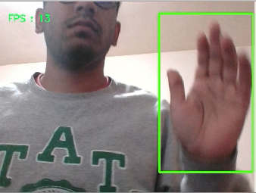
HAND SIGNALS WITH VISUAL DATA
CHALLENGES
DYNAMIC BACKGROUND
Our biggest struggle towards the end of the project was combining gesture detection with a dynamic background. We did get hand detection with a dynamic background using basic object detection models.
FEATURE SPECIFICATION
TECHNOLOGIES USED
ARCHITECTURE
DEEP LEARNING
DEMO
Notes:
FIRST PROBLEM WE FACED WAS TO FIND A WAY TO TRACK OUR HAND, THIS LED US TO A BIGGER PROBLEM WHICH WAS - HAVING A DYNAMIC BACKGROUND
BY DYNAMIC BACKGROUND HERE WE MEAN A MOVING BACKGROUND SO THAT THE USER DOES NOT HAVE TO KEEP THEIR HAND IN A SEPARATE LOCATION.

Slide 8

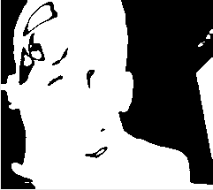
HAND SIGNALS WITH VISUAL DATA
CHALLENGES
DYNAMIC BACKGROUND
The implementation of the dynamic background however, conflicted with our implementation of gesture detection. Background subtraction was hard without image depth information. Restructuring would require a complete retraining our gesture detection model.
FEATURE SPECIFICATION
TECHNOLOGIES USED
ARCHITECTURE
DEEP LEARNING
DEMO

Slide 9
HAND SIGNALS WITH VISUAL DATA
CHALLENGES
DATASET GENERATION
Detected as Palm
Our next biggest challenge was dataset generation which eventually led to data overfitting. Because we were manually generating data from our webcams we were unable to properly cover all possible hand gestures and even covering transformations of a single gesture such as rotated, reflected, scaled and so on.
Not detected as Palm
FEATURE SPECIFICATION
TECHNOLOGIES USED
ARCHITECTURE
DEEP LEARNING
DEMO

Slide 10
HAND SIGNALS WITH VISUAL DATA
CHALLENGES
OTHER CHALLENGES
Other challenges our group faced:
Motion detection – currently we resorted to simply comparing the current and last detected gesture to combine into a gesture
Optimization – because of limited time and resources we were unable to test on multiple platforms or even ensure low power usage.
FEATURE SPECIFICATION
TECHNOLOGIES USED
ARCHITECTURE
DEEP LEARNING
DEMO

Slide 11
HAND SIGNALS WITH VISUAL DATA
CHALLENGES
FEATURE SPECIFICATION
TECHNOLOGIES USED
ARCHITECTURE
DEEP LEARNING
DEMO

Slide 12
HAND SIGNALS WITH VISUAL DATA
FEATURE SPECIFICATION
Our completed project had the following feature set:
Client Side App – with user onboarding, model downloading, starting gesture predictor, and some basic permission checking
Server Side – allows us as developers to upload new trained models, the user can then download this
Action Trigger – trigger keyboard and mouse events based on gestures
Gesture Recognition with static backgrounds (discussed later)
TECHNOLOGIES USED
ARCHITECTURE
DEEP LEARNING
DEMO

Slide 13
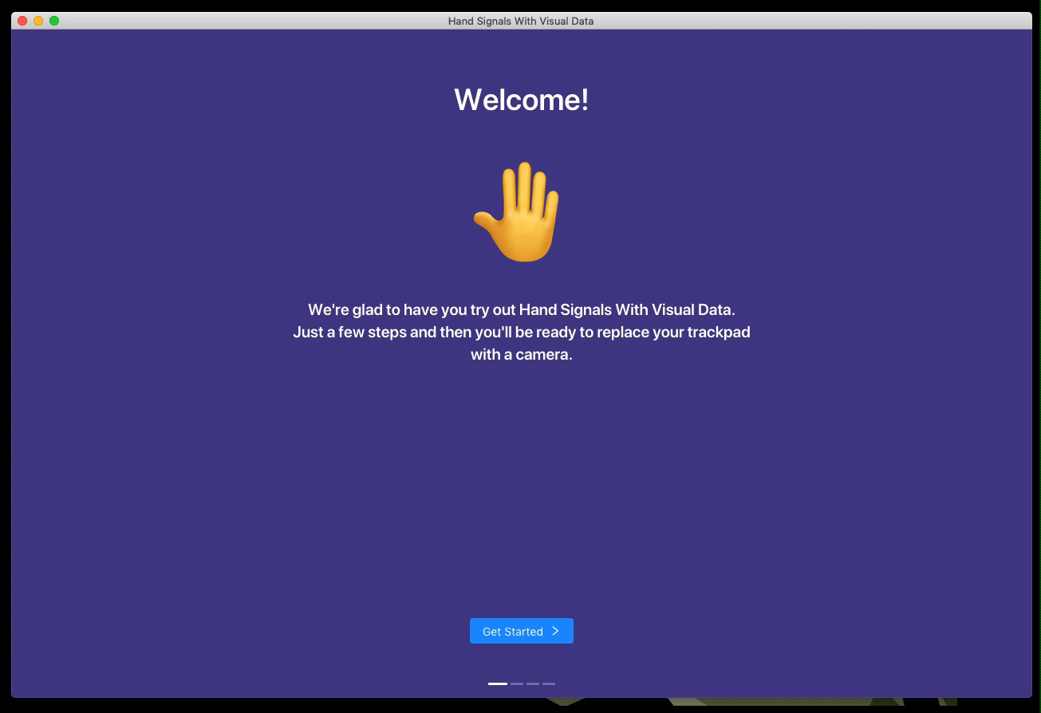
HAND SIGNALS WITH VISUAL DATA
FEATURE SPECIFICATION
CLIENT SIDE APP
TECHNOLOGIES USED
ARCHITECTURE
DEEP LEARNING
DEMO

Slide 14
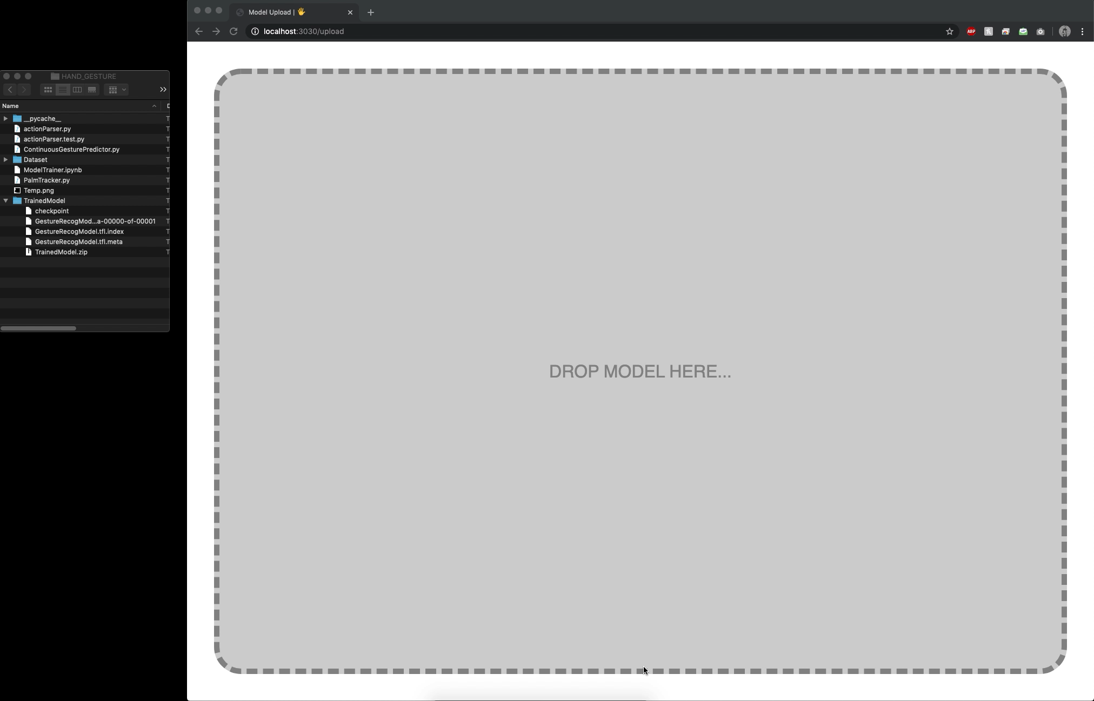
HAND SIGNALS WITH VISUAL DATA
FEATURE SPECIFICATION
SERVER SIDE
TECHNOLOGIES USED
ARCHITECTURE
DEEP LEARNING
DEMO

Slide 15
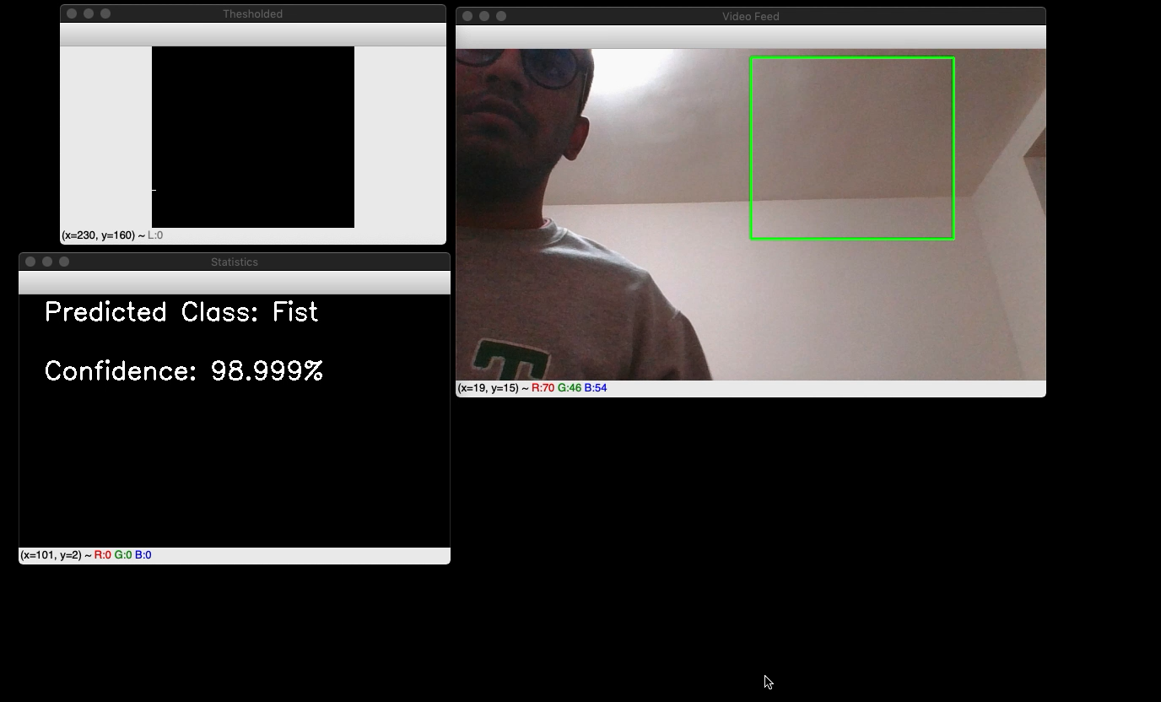
HAND SIGNALS WITH VISUAL DATA
FEATURE SPECIFICATION
ACTION TRIGGER
TECHNOLOGIES USED
ARCHITECTURE
DEEP LEARNING
DEMO

Slide 16
HAND SIGNALS WITH VISUAL DATA
FEATURE SPECIFICATION
TECHNOLOGIES USED
ARCHITECTURE
DEEP LEARNING
DEMO
Notes:
AYUSHYA

Slide 17
HAND SIGNALS WITH VISUAL DATA
TECHNOLOGIES USED
Let’s break down each feature set, to see what they’re each made of
Client Side App
Gesture Recognition (discussed in depth later)
Action Trigger
ARCHITECTURE
DEEP LEARNING
DEMO

Slide 18
HAND SIGNALS WITH VISUAL DATA
TECHNOLOGIES USED
CLIENT SIDE APP
Node JS
React JS
The client side app is built using the Electron JS framework – this allows for a single code base for cross platform app. This way the app can be built once and used on any platform.
Handles system to app communication, and app to deep learning predictor
Renders UI
ARCHITECTURE
DEEP LEARNING
DEMO

Slide 19
HAND SIGNALS WITH VISUAL DATA
TECHNOLOGIES USED
CLIENT SIDE APP
Node JS
React JS
Handles system to app communication, and app to deep learning predictor
Renders UI
ARCHITECTURE
DEEP LEARNING
DEMO

Slide 20
HAND SIGNALS WITH VISUAL DATA
TECHNOLOGIES USED
CLIENT SIDE APP TO GESTURE PREDICTOR
Node JS
React JS
Python Scripts
TensorFlow API
Our script loads our stored model and then begins continuous predictions until it is interrupted or stopped
ARCHITECTURE
DEEP LEARNING
DEMO

Slide 21
HAND SIGNALS WITH VISUAL DATA
TECHNOLOGIES USED
CLIENT SIDE APP TO GESTURE PREDICTOR
Node JS
Python Scripts
TensorFlow API
Our script loads our stored model and then begins continuous predictions until it is interrupted or stopped
ARCHITECTURE
DEEP LEARNING
DEMO

Slide 22
HAND SIGNALS WITH VISUAL DATA
TECHNOLOGIES USED
CLIENT SIDE APP TO GESTURE PREDICTOR
Node JS
Python Scripts
TensorFlow API
Action Parser
This is a custom class that abstracts a program called “cliclick”, using a custom Python dictionary that relates gestures to key event triggers
ARCHITECTURE
DEEP LEARNING
DEMO

Slide 23
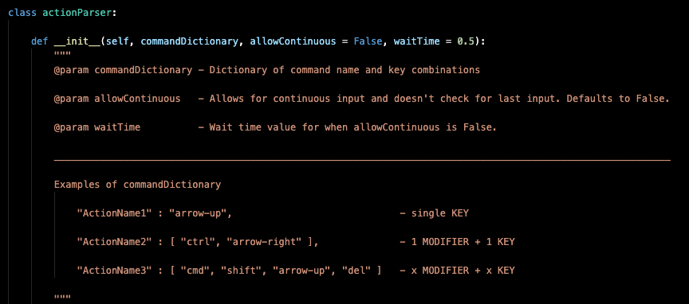
HAND SIGNALS WITH VISUAL DATA
TECHNOLOGIES USED
ACTION PARSER
This is a custom class that abstracts a program called “cliclick”, using a custom Python dictionary that relates gestures to key event triggers
ARCHITECTURE
DEEP LEARNING
DEMO

Slide 24
HAND SIGNALS WITH VISUAL DATA
TECHNOLOGIES USED
ARCHITECTURE
DEEP LEARNING
DEMO
Notes:
OMAR

Slide 25
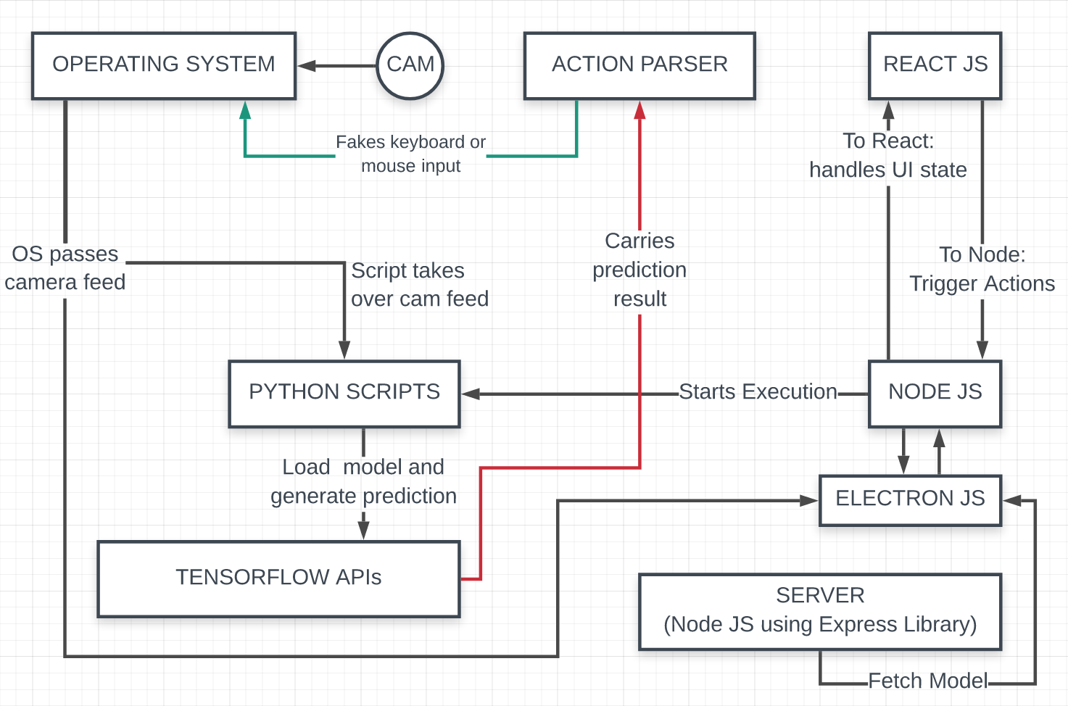
HAND SIGNALS WITH VISUAL DATA
ARCHITECTURE
Now that we’ve see the individual parts, let’s see how it all comes together
DEEP LEARNING
DEMO

Slide 26
HAND SIGNALS WITH VISUAL DATA
ARCHITECTURE
Now that we’ve see the individual parts, let’s see how it all comes together
DEEP LEARNING
DEMO
Notes:
THE USER STARTS BY INTERACTING WITH OUR REACT JS UI
ONCE THE USER COMPLETES THE ONBOARDING, THEY HAVE
THE OPTION TO START THE PREDICTOR
THIS USES THE IPC CHANNEL BETWEEN REACT AND NODE TO
REQUEST THE START OF THE PREDICTOR
OUR NODE JS CLIENT SIDE BACKEND CHECKS FOR AVAILABLE
MODELS, AND STARTS THE PREDICTOR WITH THE LATEST AVAILABLE
MODEL
AT THIS POINT OUR PYTHON SCRIPT INVOKES THE TENSORFLOW
API TO LOAD THE SAVED MODEL AND TAKES OVER THE WEBCAM
FEED TO RUN THE PREDICTOR
THE PREDICTOR THEN RETURNS ITS PREDICTION, AND USES OUR CUSTOM
ACTION PARSER WHICH WE EXPLAINED EARLIER TO SIMULATE KEY PRESSES
INTO THE OPERATING SYSTEM

Slide 27
HAND SIGNALS WITH VISUAL DATA
ARCHITECTURE
With all the other parts of the feature sets covered, let’s now dive into the deep learning details of the project
DEEP LEARNING
DEMO
Notes:
THE USER STARTS BY INTERACTING WITH OUR REACT JS UI
ONCE THE USER COMPLETES THE ONBOARDING, THEY HAVE
THE OPTION TO START THE PREDICTOR
THIS USES THE IPC CHANNEL BETWEEN REACT AND NODE TO
REQUEST THE START OF THE PREDICTOR
OUR NODE JS CLIENT SIDE BACKEND CHECKS FOR AVAILABLE
MODELS, AND STARTS THE PREDICTOR WITH THE LATEST AVAILABLE
MODEL
AT THIS POINT OUR PYTHON SCRIPT INVOKES THE TENSORFLOW
API TO LOAD THE SAVED MODEL AND TAKES OVER THE WEBCAM
FEED TO RUN THE PREDICTOR
THE PREDICTOR THEN RETURNS ITS PREDICTION, AND USES OUR CUSTOM
ACTION PARSER WHICH WE EXPLAINED EARLIER TO SIMULATE KEY PRESSES
INTO THE OPERATING SYSTEM

Slide 28
HAND SIGNALS WITH VISUAL DATA
ARCHITECTURE
With all the other parts of the feature sets covered, let’s now dive into the deep learning details of the project
DEEP LEARNING
DEMO

Slide 29
HAND SIGNALS WITH VISUAL DATA
ARCHITECTURE
DEEP LEARNING
DEMO

Slide 30

HAND SIGNALS WITH VISUAL DATA
DEEP LEARNING
In our project, we will utilize deep learning by gathering visual data from a webcam and use that data to trigger commands in the user’s machine. Our group picked CNN because of its ability to process images. Other neural networks, such as RNN, cannot excel in this task.
DEMO

Slide 31
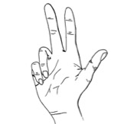
HAND SIGNALS WITH VISUAL DATA
DEEP LEARNING
WHY CONVOLUTIONAL NEURAL NETS
CNNs can be thought of automatic feature extractors from the image.
A CNN effectively uses adjacent pixel information to effectively down-sample the image first by convolution and then uses a prediction layer at the end.
Prior to CNN, algorithm-based image classification required manual feature extraction.
DEMO
Convolution – receiving input signals from another layer and using filters/kernels to convolve across the input. This is where the network “learns” important filters as it runs.
INPUT IMAGE TO FEATURE MAPS

Slide 32
HAND SIGNALS WITH VISUAL DATA
DEEP LEARNING
BUILDING BLOCKS OF CONVOLUTIONAL NEURAL NETS
Convolution – receiving input signals from another layer and using filters/kernels to convolve across the input. This is where the network “learns” important filters as it runs.
INPUT IMAGE TO FEATURE MAPS
DEMO
Subsampling – also known as pooling layer. It reduces the dimensions of data with a filter size and a stride and also controls overfitting. It is usually inserted after a convolution.
Activation – controls how information flows from one layer to another.
Fully connected – connects all neurons in a layer from its previous layer to its sub-layers.

Slide 33
HAND SIGNALS WITH VISUAL DATA
DEEP LEARNING
BUILDING BLOCKS OF CONVOLUTIONAL NEURAL NETS
Convolution – receiving input signals from another layer and using filters/kernels to convolve across the input. This is where the network “learns” important filters as it runs.
Subsampling – also known as pooling layer. It reduces the dimensions of data with a filter size and a stride and also controls overfitting. It is usually inserted after a convolution.
SUBSAMPLING FROM FEATURE MAPS
DEMO
Activation – controls how information flows from one layer to another.
Fully connected – connects all neurons in a layer from its previous layer to its sub-layers.

Slide 34
HAND SIGNALS WITH VISUAL DATA
DEEP LEARNING
BUILDING BLOCKS OF CONVOLUTIONAL NEURAL NETS
Subsampling – also known as pooling layer. It reduces the dimensions of data with a filter size and a stride and also controls overfitting. It is usually inserted after a convolution.
CONVOLVE POOLED LAYERS
DEMO
Activation – controls how information flows from one layer to another.
ReLU stands for rectified linear unit and is a type of activation function. Simply, allows activation when filter is outputs a positive value.
Fully connected – connects all neurons in a layer from its previous layer to its sub-layers.
Notes:
CHRIS IS GOING TO EXPLAIN THE REMAINING ASPECTS
AND THE DETAILS OF OUR MODEL

Slide 35
HAND SIGNALS WITH VISUAL DATA
DEEP LEARNING
BUILDING BLOCKS OF CONVOLUTIONAL NEURAL NETS
Activation – controls how information flows from one layer to another.
ReLU stands for rectified linear unit and is a type of activation function. Simply, allows activation when filter is outputs a positive value.
Subsampling – also known as pooling layer. It reduces the dimensions of data with a filter size and a stride and also controls overfitting. It is usually inserted after a convolution.
FLATTEN AND FULLY CONNECT
USING ReLU ACTIVATION
DEMO
Fully connected – connects all neurons in a layer from its previous layer to its sub-layers.

Slide 36
HAND SIGNALS WITH VISUAL DATA
DEEP LEARNING
BUILDING BLOCKS OF CONVOLUTIONAL NEURAL NETS
Activation – controls how information flows from one layer to another.
ReLU stands for rectified linear unit and is a type of activation function. Simply, allows activation when filter is outputs a positive value.
Fully connected – connects all neurons in a layer from its previous layer to its sub-layers.
RESULT IS A FULLY CONNECTED
NEURAL NET – READY TO MAKE
PREDICTIONS
DEMO

Slide 37
HAND SIGNALS WITH VISUAL DATA
DEEP LEARNING
CONVOLUTIONAL NEURAL NET PUT TOGETHER
Fully connected – connects all neurons in a layer from its previous layer to its sub-layers.
DEMO

Slide 38
HAND SIGNALS WITH VISUAL DATA
DEEP LEARNING
OUR CNN MODEL
CONVOLUTION
+ ACTIVATION
(32,198,198)
CONVOLUTION
+ ACTIVATION
(32,196,196)
POOLING
& DROPOUT
(32,98,98)
FLATTEN
(307328)
DENSE, ACTIVATION
& DROPOUT
(128)
FULLY
CONNECTED
(5)
DEMO

Slide 39
HAND SIGNALS WITH VISUAL DATA
DEEP LEARNING
DEMO
CONVOLUTION
+ ACTIVATION
(32,198,198)
CONVOLUTION
+ ACTIVATION
(32,196,196)
POOLING
& DROPOUT
(32,98,98)
FLATTEN
(307328)
DENSE, ACTIVATION
& DROPOUT
(128)
FULLY
CONNECTED
(5)

Slide 40
HAND SIGNALS WITH VISUAL DATA
Q&A

Slide 41
HAND SIGNALS WITH VISUAL DATA
THANK YOU

Slide 42
HAND SIGNALS WITH VISUAL DATA
BY
AYUSHYA AMITABH
CHRIS PANICAN
GERRY XU
OMAR ELNAGDY

